Slide 1
ISO 25964-1 working group ISO/TC 46/SC 9/WG 8
Information and documentation —
Thesauri and interoperability with other vocabularies —
Part 1: Thesauri for information retrieval,
creation, management, and use
Presented by Marjorie Hlava, Convenor

Slide 2
History
Sputnik – 1957- space race and cold war…
Information overload – need to organize and retrieve
Using thesaurus for information retrieval
COSATI pioneering work in the 1960s – 1967 thesaurus TEST
By 1974 the “principles and practical guidance for constructing thesauri”
ISO 2788 and ANSI/NISO Z39.19
Replaced
◦ ISO 2788-1986 Guidelines for the establishment and development of monolingual thesauri
◦ ISO 5964-1985 Guidelines for the establishment and development of multilingual thesauri
Built on BS 8723
Structured vocabularies for information retrieval – Guide
Published 2005-2008

Slide 3
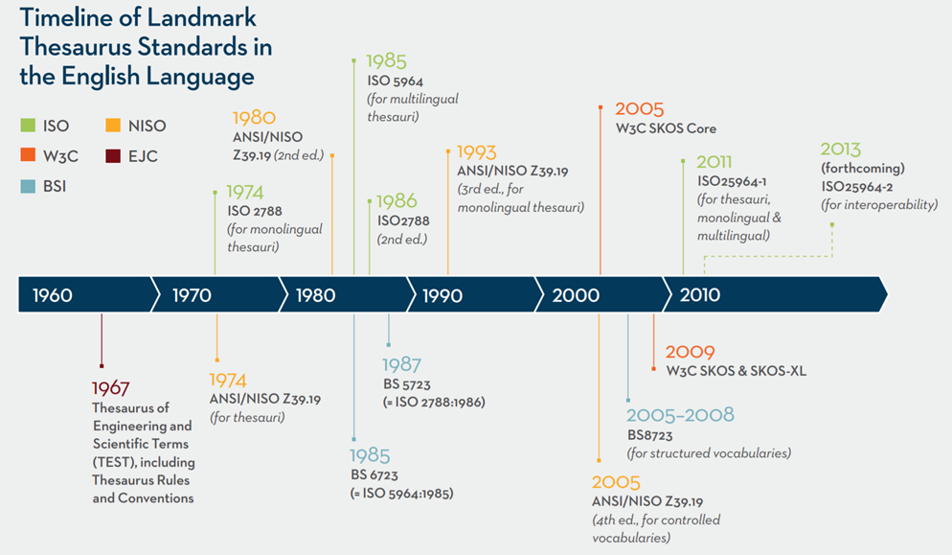
From ISO 2788 to ISO 25964: The Evolution of Thesaurus Standards towards Interoperability
and Data Modeling - Stella G. Dextre Clarke & Marcia Lei Zeng - 2012

Slide 4
Overview – ISO 25964
Published in 2011
Current edition
Clauses 1 – 14 Definitions, Historical
Clause 15 - Data Model
Clause 16 - Integrations
Clause 17 - Exchange formats
Clause 18 - Protocols
2 Annexes with sample thesauri
ISO 25964 - Part 2 Interoperability – all new in 2011 ...
Merges Mono and Multilingual to a single work
Concentrates on development and maintenance –
(Does not include on how to use in indexing)
Extensive Models and ties to SKOS and UML

Slide 5
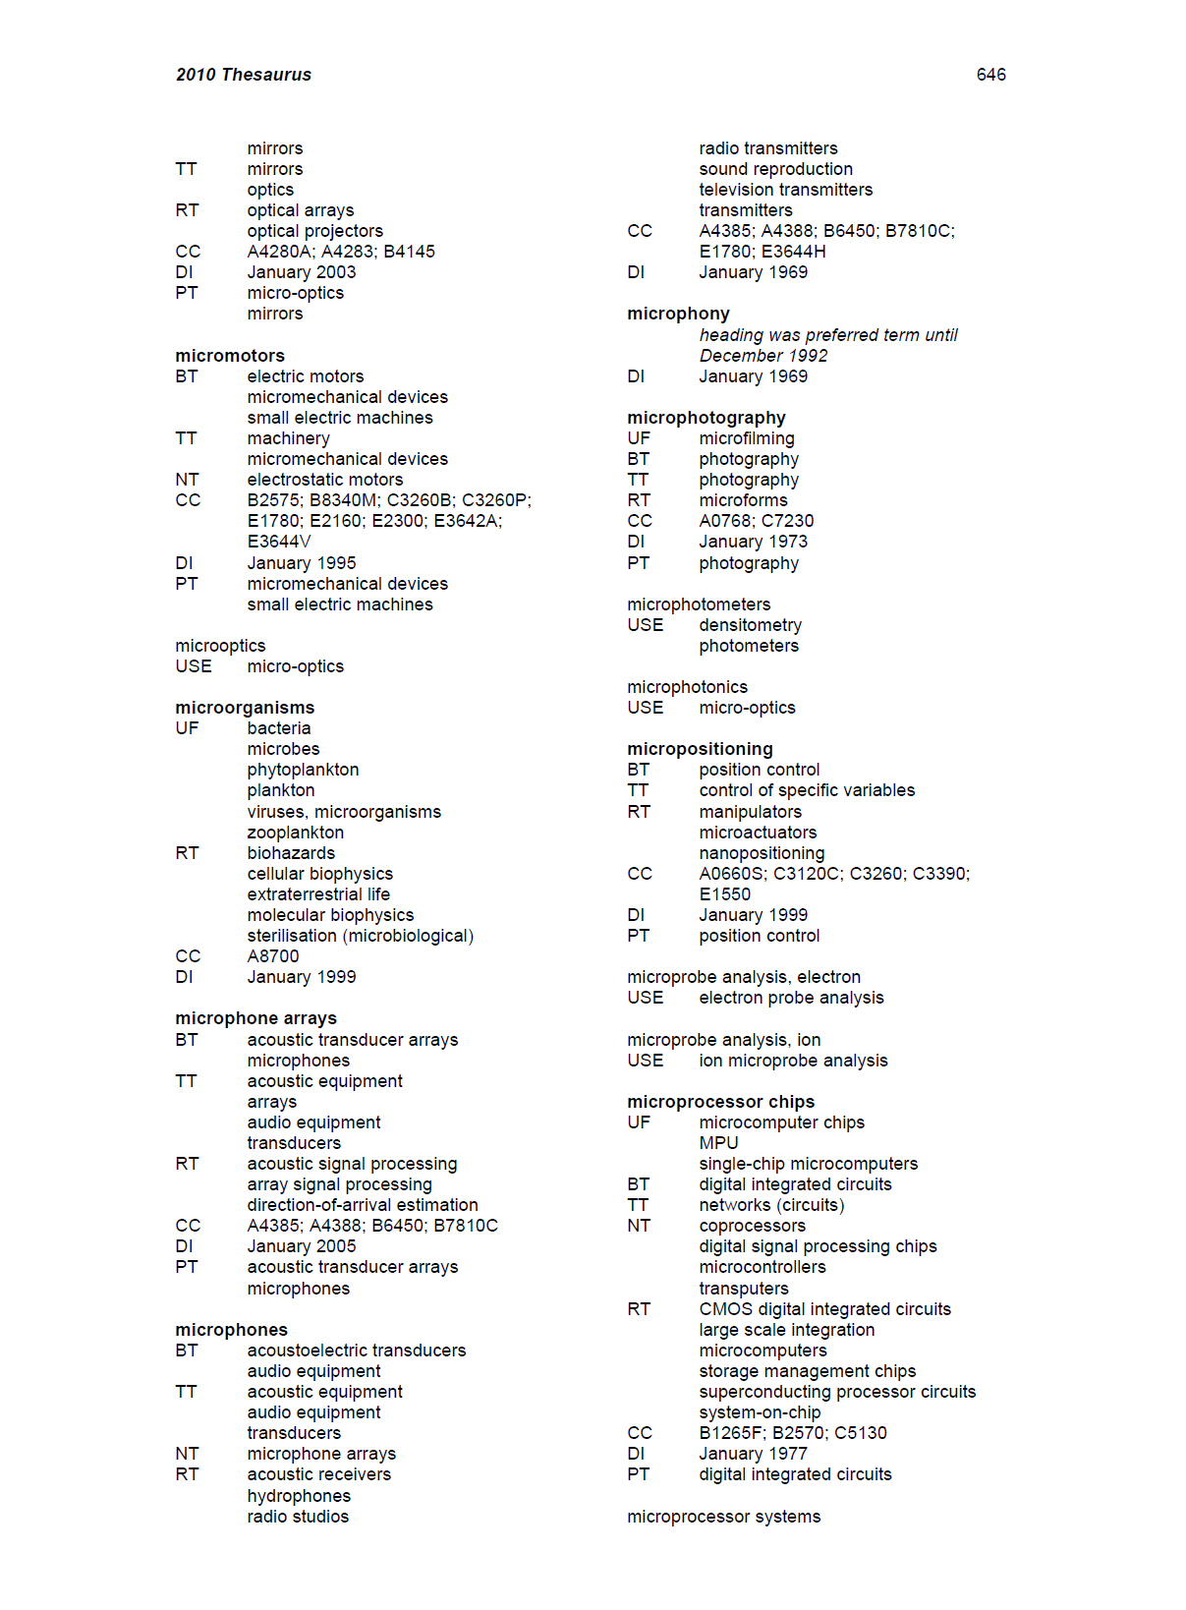
Outside interest
The digital world has changed
Thesauri and taxonomies are used broadly
Not just for search and retrieval anymore
Now the world has changed again.
Little use of paper indexes
Online
Interconnected information resources
Ontologies - Valley of disillusionment
Tried knowledge graphs to fill the void?
Chat GPT?
Generative AI?

Slide 6
Now - Expanded Use Cases
Moved from Paper indexes – A&I
Software based tools
Search expansion
Tagging / indexing for retrieval
Alt term suggestions
Support of clustering and other ontological options
Shopping carts
Web navigation
Collection organization
Chatbots
Decision trees
Profiles - members, authors,
Semantic fingerprints
Knowledge graphs
Human intelligence bases
Artificial Intelligence,
Generative AI
Search query triples
Conference track sorting
Peer Review keywords
Interoperability – with what?
Etc.

Slide 7
Gathering additional information
Reached out to the potential user communities
Taxonomy Division SLA
Taxonomy Book Camp – KM World
List Serves for taxonomy groups
Taxodiary Blog
Software developers
Known authors in the field
Previous members of the committee
NISO, ASIST, SLA NKOS Members
150+ responded
Many with comments
Bring them on to the committee
A few roadblocks – not an open process.
Reading literature for other thoughts
Looking at other ISO terminologies and taxonomies and thesauri
Need to approach the SKOS community
Etc.

Slide 8
Committee Members
Bailey, Keondra
Blinco, Kerry
Blumauer, Andreas
Busch, Joseph
Carpenter , Todd
Chandru, Sheeba
Clark, Dave
Drage, Anna
Ermert, Axel
Fanning, Betsy
Gillikin, David
Harpring, Patricia
Hedden, Heather
Hlava, Margie
Lamorte, Michele
Liu, Hua
Lykke, Marianne
McCoy, Amy
Moscara, Elisabeth
Scheven, Esther
Schutte, Deon Du Preez
Tennis, Joseph T
Tudhope, Douglas
Yancey, Trish
Zeng, Marcia
Formal admission process
Must be part of ISO TC 46/SC 9 member country
One of those is NISO for the US experts
Ponderous (Thanks for Betsy Fanning)
NO outside or Advisory committee allowed
Marjorie M.K. Hlava, Convenor
Betsy Fanning and Keondra Bailey - staff
…. So

Slide 9
Current Timeline
Convene committee Fall of 2023
152 people replied with comments and thoughts
Many rules for members
Acquire and get current standard edition to committee
Brainstorming sessions - ongoing
Washington, DC Nov 5, 2023 – 52 signed up
With Taxonomy Boot Camp
Wuhan, China March 30, 2024
ISKO NKOS Workshop
Working on one in Europe
Comments began October 2023
Distributed first annotated edition February 2024
First draft due in June 2024
3 full years to complete
But only 6 months to write

Slide 10
Other connected standards
ISO terminologies over 50!! of them
We have a list
Need to contact them
Form a cross walk
ISO 25964 is hosted by NISO
NISO Z39.19
BSI
DIN
SKOS – W3C
OWL
SKOS - Thes Namespace built for OWL now hosted by DCMI
Learning of more daily
https://www.dublincore.org/specifications/skos-thes/

Slide 11
SKOS Impact
ISO 25964-1 - how to build and manage a vocabulary
SKOS - how to publish a vocabulary in a machine-processable format.
The data models for both standards are concept-based.
ISO 25964 model provides for all features of a thesaurus
SKOS model aims to serve several different vocabulary types.
It does not provide for some thesaurus features.
Easy to convert – but not all features

Slide 12
Decisions Made So Far
Concept and term labels
(not just term)
Investigate adding Part 2 – Interoperability
Cross walks to TC 37 in process of being established, examples:
ISO 704 - Terminology work - Principles and methods
ISO 1087 - Terminology work and terminology science
ISO 30042 becoming 24634 - Management of terminology resources TBX
Include more use cases and more language examples

Slide 13
Considering
Preferred / Non-Preferred labels
Image thesauri
Move Clauses 14 – 18 to Annexes or entirely
Add the Zthes Specifications
Term ID – UID? URL?
…more

Slide 14
Current Status
First annotated draft has been distributed in rotation
Need more outside suggestions and outreach
Like this meeting
Committee will divide into groups to work on
Extensions
Existing Clauses,
Annexes
Other standards

Slide 15
That’s it for now - It’s a big task Join the mailing list? Join the fun? Contact us! I look forward to your suggestions
Marjorie M.K. Hlava
Chief Scientist
Access Innovations, Inc.
mhlava@accessinn.com

