Slide 1
Marjorie M. K Hlava, 505-998-0800
Chief Scientist, Chairman, President, Founder
Mhlava2accessinn.com
A Presentation On
How Search Works With Taxonomies

Slide 2
Description:
Have you ever wondered how search works while visiting an e-commerce site, internal website, or searching through other types of online resources? Look no further than this informative session on the ways that taxonomies help end-users navigate the internet! Hear from taxonomists and other information professionals who have first-hand experience creating and working with taxonomies that aid in navigation, search, and discovery across a range of disciplines.

Slide 3
Who is speaking? Marjorie M.K. Hlava
I am a lifetime member 45 years of SLA, joining in 1974.
I have spent my career searching, building databases, building taxonomies, First for NASA then for my own company.
Over 2000 engagements and 600 custom taxonomies built by my team and me.
Also active in the standards we use you will find my name in the Dublin core (Z39.84), Controlled vocabulary (Z39.19), Credit, DOI Syntax and other infrastructure standards for the information industry.
I am the founding chair of the SLA taxonomy division
I have written four books and the Taxobook series is a best seller on Amazon. I also have authored over 200 articles and any presentations

Slide 4
Content Without Access Is Nearly Worthless.
Enterprise search is how an organization
… helps people seek the information they need,
… in any format,
databases,
document management systems
paper.
… from anywhere inside their company.
We need to get the right information at the right time.

Slide 5
What’s the problem with search?
Returns do not match the query – search question
Need to know all the ways something can be labeled to find it, synonyms
Colloquial use of terms to mean something else, homonyms
Too many returns to look at easily
Users only want to click 3 times to find an answer
Too much time needed to set up good search system by IT
Most orgs have 5 previous search systems on the shelf – trying a new one
The problem was probably the data not the system.

Slide 6
Is All Search The Same?
Key outcomes in a comprehensive knowledge management strategy.
Discover “discoverability”
Search
Find “findability”

Slide 7
Search Behavior Types
Findability
The ease with which information can be found. Means users can easily find content or information present on a website or in a database.
Discoverability
Making sure that new content or information can be found
… even if the user doesn’t know that it exists yet.
Browse
Like in a library or bookstore – allows serendipity in search
Each type needs different support from the search system
Taxonomies provide consistency in terms and categories to enable findability in content. This is true regardless of the subject.

Slide 8
How do we measure good search results?
Relevance
The systems guess at what you are looking for
Precision
Returning only those items which exactly match the query – search question
Recall
Returning ALL the items in the data base which match the search query
Match against human vetted sets
Training sets or humanly indexed data
Indexing indicates a controlled list of terms

Slide 9
What Search Using a Taxonomy OUGHT To Do!!
Gives precedence to Taxonomy terms in search
Search by Navigation tree
Expand search by Related terms
Refine search via Narrower terms
Type ahead shows both terms and synonyms
Permuted list format
Suggests preferred term if synonym is entered in search box
Provide for recursive search (Search within a search set)
Give recommendations

Slide 10
What are the Parts of Search?
Search software
Inverted Index
Search algorithms
Content layer
Rich metadata
Consistent format
Presentation layer (User Interface)
Search box
Auto-completion
Related content
Advanced search options

Slide 11
Search Software Content Layer Adding the Taxonomy Presentation layer (User Interface)

Slide 12
Sample – Lucene Deployment
Query
Query fetches hit list from Search, snippets from Repository.
Search Presentation
Layer
Search
Data forked so components can serve snippets and docs, and Lucene can build indexes.
Lucene
Index
Auto-completion
NavTree
Narrower Terms
Related Terms
Etc.
Building Lucene index
Cleanup, etc.
Data base in (JATS) XML
Repository with fielded data

Slide 13
The inverted index is the heart
If its not in the inverted index.... It is not searchable!

Slide 14
“Outline of Presentation”
Sample DOCUMENT
Define key terminology
Thesaurus tools
Features
Functions
Costs
Thesaurus construction
Thesaurus tools
Why & when?
Creating an Inverted File Index

Slide 15
Simple Inverted File Index of
the Terms from the “Outline”
&
1
2
3
4
construction
costs
define
features
functions
key
of
outline
presentation
terminology
thesaurus
tools
when
why

Slide 16
Complex Inverted File Index:
Placement, Location added
key - L2, P2, H
of - Stop
outline - L1, P1, T
presentation - L1, P3, T
terminology - L2, P3, H
thesaurus - (1) - L3, P1, H
(2) - L7, P1, SH
(3) - L8, P1, SH
tools - (1) - L3, P2, H
(2) - L8, P2, SH
when - L9, P3, H
why - L9, P1, H
& - Stop
1 - Stop
2 - Stop
3 - Stop
4 - Stop
construction - L7, P2, SH
costs - L6, P1, H
define - L2, P1, H
features - L4, P1, SH
functions - L5, P1, SH

Slide 17
Search for thesaurus tools
Search = Thesaurus tools
thesaurus - (1) - L3, P1, H
(2) - L7, P1, SH
(3) - L8, P1, SH
tools - (1) - L3, P2, H
(2) - L8, P2, SH

Slide 18
Lucene - SOLR Search Flow
Data Store
MySQL??
Solr Software
User Interface
Inverted file
Fielded data
Query
Answer
Query

Slide 19
Search Software Content Layer Adding the Taxonomy Presentation layer (User Interface)

Slide 20
So how do we get there?
Have to tag the records
Semantically enrich
Add subject metadata
Create a controlled vocabulary
Use good metadata at the input and the search ends of the pipeline

Slide 21
The Workflow
Build
Search
inverted index
Create
user
interface
Gather
source
data
Tag and
Create
metadata
Put in
data base
with tags
Client Data
Full Text
HTML, PDF,
Data Feeds, etc.
Automatic Summarization
Search
Presentation Layer
Increases
accuracy
Browse by Subject
Auto-completion
Broader Terms
Narrower Terms
Related Terms
Machine Aided Indexer (M.A.I.™)
Database
Repository
Search
Software
Inline Tagging
Client taxonomy
Client Taxonomy
Metadata and Entity Extractor
Thesaurus Master

Slide 22
Where does the taxonomy get
added to the production workflow?
>>>>>>>>>>>>>>>>>>>>

Slide 23
Raw Full text data feeds
Adding The KOS To Text
SQL for ecommerce
Document creation and storage
Printed source materials
Journal Platform
XML Source data
Content repository
Taxonomy terms
Add other metadata
Data Crawls on sources
Load to
Lucene
Search
User Interface
Conference data

Slide 24
JATS
JATS
MAI 3.x
Thes Terms
Thes
Indexing using the controlled vocabulary or thesaurus / taxonomy will return basic thesaurus terms to be converted into enriched data (like JATS XML for ingestion as the “Article of Record” storage).

Slide 25
Rulebase
MAI Returns
<term>
<term>
<term>
Enhanced JATS XML File
JATS
People Rulebase
Orgs Rulebase
Global Spec Rulebase
Geo Rulebase
Using all three thesauri along with Global Spec and MAI Inline Tagging (in full text) returns thesaurus terms and a semantically enhanced file.
MAI Inline Full Text
Thesaurus
Archive
Search
Geo Thes
XIS People
XIS Orgs
TM - MAIstro
Global Spec Thes
Lists - Extraction
People Thes
Orgs Thes

Slide 26
Rulebase
MAI Returns
<term>
<term>
<term>
Enhanced JATS XML File
JATS
People Rulebase
Orgs Rulebase
Global Spec Rulebase
Geo Rulebase
Using all three thesauri along with Global Spec and MAI Inline Tagging (in full text) returns thesaurus terms and a semantically enhanced file.
MAI Inline Full Text
Thesarus
XML JATS
Archive
Geo Thes
TM - MAIstro
XIS People
XIS Orgs
Global Spec Thes
Lists - Extraction
People Thes
Orgs Thes
Triplestore
ML 9.0
RDF
Search System

Slide 27
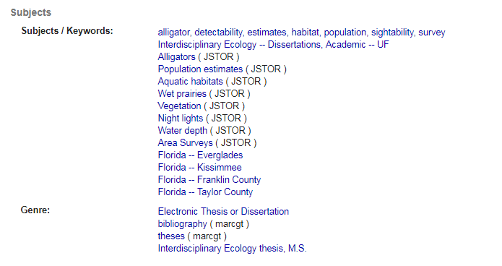
Florida Thesis Project
Sample records from the pilot project clearly demonstrate the enhanced metadata:
Semantically Enhanced Record
Original Record
9
Notes:
MARGIE: Students can add keywords as they submit their theses or dissertations, but they are not metadata experts. The Libraries sometimes add an LCSH subject heading and genre is usually captured during the submission process.
As you can see, the first two and last four lines remain the same in both records, but the automated process added 12 additional controlled vocabulary terms, several of which clearly identified this as a thesis about specific geographic areas in Florida and therefore appropriate for inclusion in the Portal of Florida History. This provides the user several more points for retrieval and access to the data held int he respository.

Slide 28
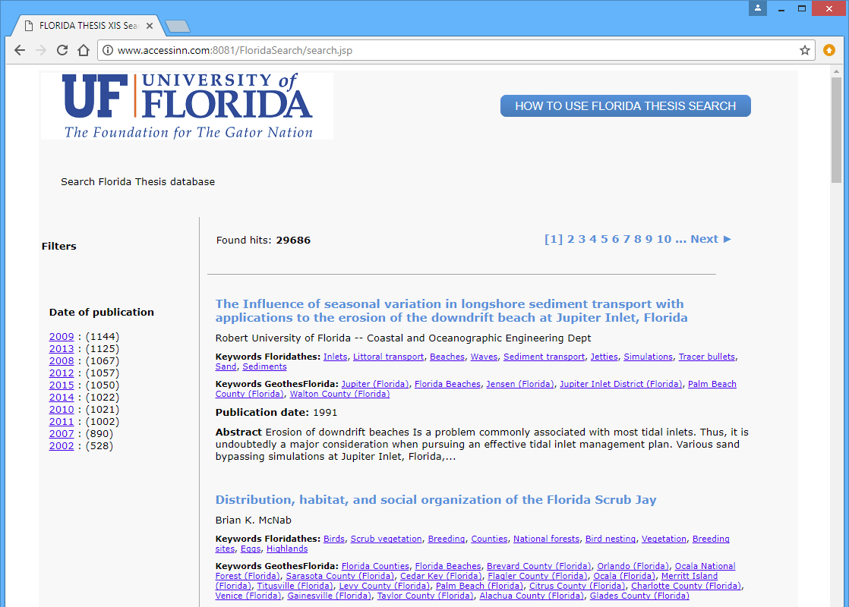
Florida Thesis Project
University of Florida
Digital Collections
XML Records & Full Text Exported from UFDC for Analysis
MARC Records Exported from XML
XIS
XML CMS System
UF Theses & Dissertations
Digital Library of the Caribbean
Enhanced Metadata Added to UFDC Records
Portal of Florida History
XIS Staff Review Panel
Cuban Heritage Collection
IR@UF
XIS Repository of Updated Records
Updated Records Returned to UFDC
10
Notes:
MARGIE: As a result of this work by Access Innovations, UF now has a taxonomy of Florida specific terms that it can maintain and expand and then use to manage both print and digital collections.
Use of this taxonomy as the default search option in UFDC will provide a minimum of 85% accuracy in retrieval. Retrieval is only 55-60% accurate in enhanced FT only using standard search. Simultaneous use of the taxonomy and full text search increases the precision of the search results only 6-7% because of the extraneous items that are retrieved. BUT targeting the search to fist use ONLY the controlled vocabulary increases search precision to nearly 100%. This is the value of controlled vocabulary indexing. The search system is then routed to the full text when no or small results are returned.
The search system used in the XIS is Lucene, a basic Bayesian search which has been augmented to make full use of the taxonomy terms.
The current work flow is to process the thesis first, and then add additional collections increasingly process by the UF Staff directly

Slide 29
Planned Florida Record Creation
All Records Created in XIS
UFDC
UFDC
XIS Data Input Panel
XIS
XML CMS System
UFDC
UFDC
dLOC
XML Records Exported from XIS to UFDC/dLOC
MARC Records Exported from XIS to OCLC
UF Libraries OPAC/ Discovery Service
XIS Repository of UF Records
MARC Records Exported from XIS to the UF Libraries OPAC/Discovery Service
17
Notes:
MARGIE: This diagram shows the revised work flow for title by title cataloging. Catalogers will use the XIS Data Input Panel, which will prompt for the appropriate thesaurus terms. Once the XML files are in the repository, records will be output in the format needed by the recipient services.
This streamlined process supports as any exports as desired – there are four at present – to consuming applications. It covers the cataloging process from any source whether digital or print.

Slide 30
Document submission uploads - Smart Submit

Slide 31
Search Software Content Layer Adding the Taxonomy Presentation layer (User Interface)

Slide 32
All the taxonomy
Hierarchical relationships
The broader narrower
Browse and Discovery
Equivalence relationships
Synonyms
Findability
Associative terms
Related but not synonyms or hierarchical
Knowledge maps
Cross area searching
Ontologies
Linking
Alphabetic views for type ahead

Slide 33
Non-intuitive Synonyms
Invasive breast cancer
Metastatic breast cancer
Stage IV breast cancer
These all mean the same thing in MeSH, etc. (as well as in the ASCO thesaurus)

Slide 34
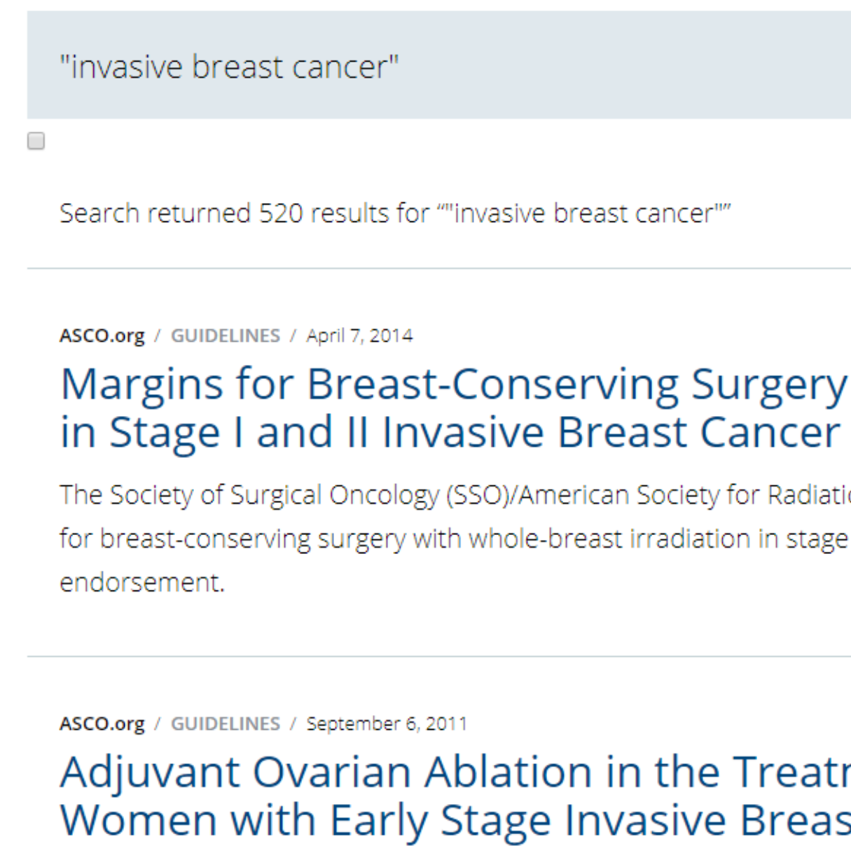
Lack of Synonymy Breaks Search
520 hits

Slide 35
Lack of Synonymy Breaks Search
1803 hits

Slide 36
Lack of Synonymy Breaks Search
73 hits
I would want my medical team to
see all 2,396 articles

Slide 37
Disambiguation
Bridge
Structure
Bridge
Dentistry
Bridge
Game
Bridge
Concept

Slide 38
Achieving Synonymy
Find
Find like concepts
Merge
Merge the terms
Choose
Choose a preferred form
Build
Build term record
Hierarchy
Equivalence
Associative

Slide 39
Integration into Search
Mandatory input fields, Fixed-length, Display fields in the result, Searchable fields, Subfields
Database indexing behavior
Allows for custom indexing behavior
Search types
Word parse, phrase parse, and indexing terms
Boolean search types: Equals, Not, Or, Number, Exact matches, etc.…
Can be mixed and matched based on the desired query
Sortable fields
Sort fields in export or other views (already in-spec)
Search implementation
Search against title, abstract, descriptors, organizations, people names, and geographic information
Allows for map-integration
Utilize a GIS field for presenting the location meta-data of records

Slide 40
Content Management – More Than Just Documents
Content management is much more than acting as a document store
Ability to upload and store additional data-types
Videos
Images
Files
Excel
Word
Etc.…
Ability to serve the content along-side the document
API’s to access and deliver the objects
While AWS provides this, it is generally very complex
XIS simplifies this process via understanding the target audience
Challenges for libraries
Systems are often designed for naïve implementations
Storage of books and journals and the like
XIS solves this by giving a use-case specific implementation of CMS

Slide 41
Search Software Content Layer Adding the Taxonomy Presentation layer (User Interface)

Slide 42
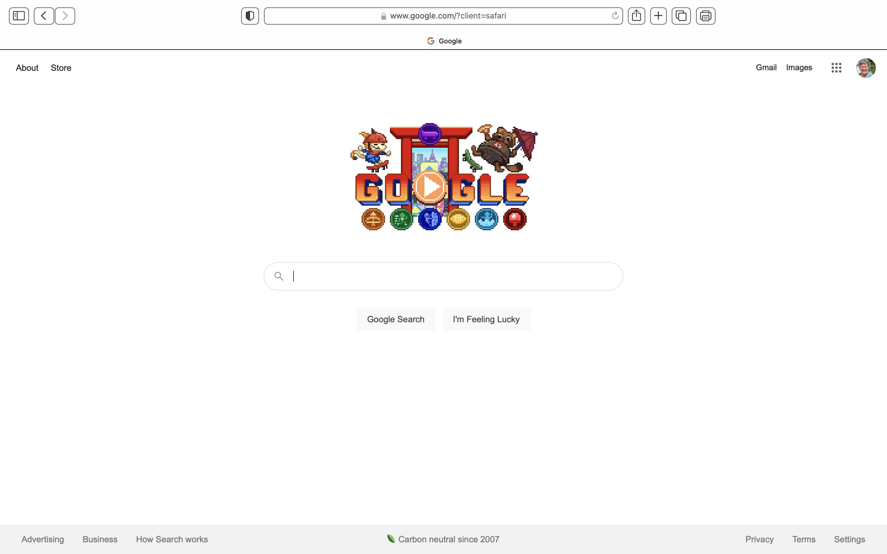
Just give me Google!

Slide 43
Google
Billions of pages
Trillions of queries
15% new topics each day
User Contributed Content
Ranking of pages
Synonyms
Interpretive meaning of query
understanding exactly what you mean and giving you back exactly what you want
Doesn't work on small collections

Slide 44
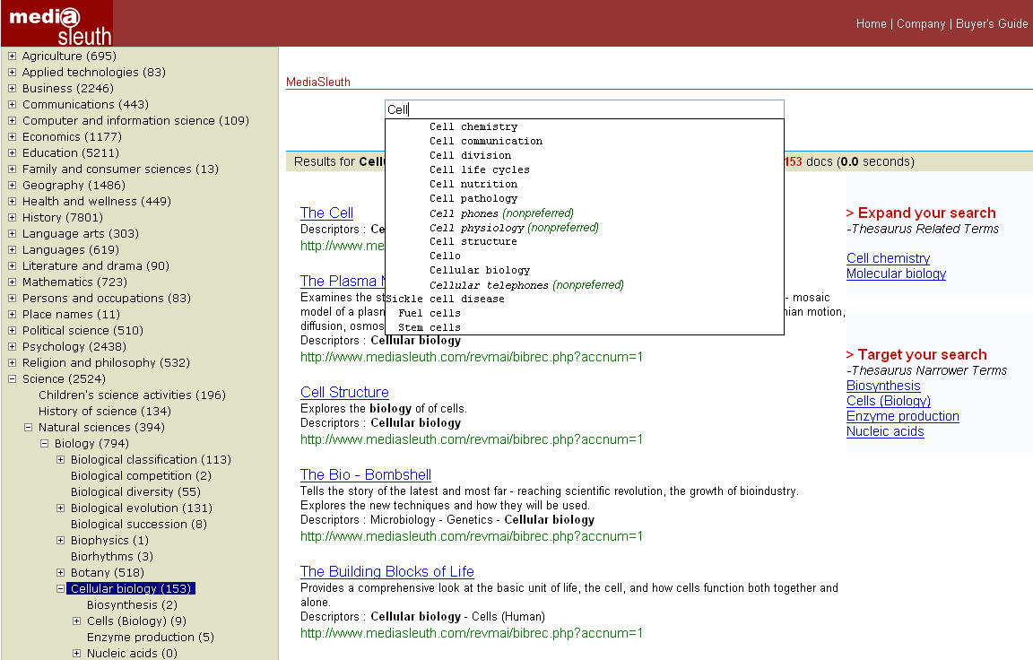
Taxonomy Search
Auto-completion Using the Taxonomy
Guide the user by applying various semantic relationships
Navigate the full Taxonomy “tree”

Slide 45
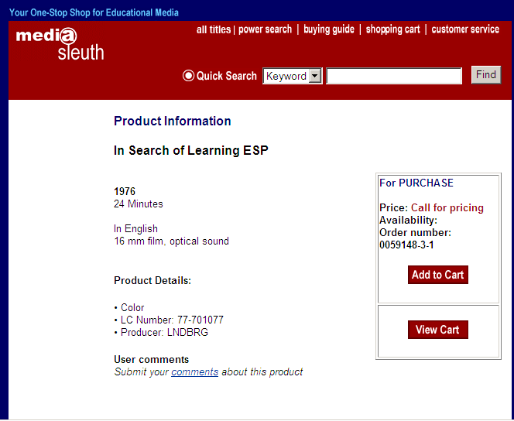
Direct link to e-commerce to improve sales
Link search and taxonomy directly to the supply or documents or by redirecting to a shopping cart

Slide 46
Link to Additional Resources
CME Activity on Topic A
Upcoming Conference on Topic A
Other Journal Articles on Topic A
Job Posting for Expert on Topic A
Journal Article on Topic A
Grant Available for Researchers Working on Topic A
Podcast Interview with Researcher Working on Topic A
Author Networks
Social Networking
CONFIDENTIAL
Notes:
Thanks to Helen Atkins of AACR for this illustration.
The real power of this is that the links can all go in all directions, so we take advantage of having the user’s attention regardless of how they step into our “web”
46

Slide 47
Sample Linked Page
Cancer Epidemiology Biomarkers & Prevention
Vol. 12, 161-164,
February 2003 © 2003 American Association for Cancer Research Short Communications
Alcohol, Folate, Methionine, and Risk of Incident Breast Cancer in the American Cancer Society Cancer Prevention Study II Nutrition Cohort
Heather Spencer Feigelson¹, Carolyn R. Jonas, Andreas S. Robertson, Marjorie L. McCullough, Michael J. Thun and Eugenia E. Calle Department of Epidemiology and Surveillance Research, American Cancer Society, National Home Office, Atlanta, Georgia 30329-4251
Recent studies suggest that the increased risk of breast cancer associated with alcohol consumption may be reduced by adequate folate intake. We examined this question among 66,561 postmenopausal women in the American Cancer Society Cancer Prevention Study II Nutrition Cohort.
Related Press Releases
How What and How Much We Eat (And Drink) Affects Our Risk of Cancer
Novel COX-2 Combination Treatment May Reduce Colon Cancer Risk Combination Regimen of COX-2 Inhibitor and Fish Oil Causes Cell Death
COX-2 Levels Are Elevated in Smokers
Related AACR Workshops and Conferences
Frontiers in Cancer Prevention Research
Continuing Medical Education (CME)
Molecular Targets and Cancer Therapeutics
Related Meeting Abstracts
Association between dietary folate intake, alcohol intake, and methylenetetrahydrofolate reductase C677T and A1298C polymorphisms and subsequent breast
Folate, folate cofactor, and alcohol intakes and risk for colorectal adenoma
Dietary folate intake and risk of prostate cancer in a large prospective cohort study
Related Working Groups
Finance
Charter
Molecular Epidemiology
Think Tank Report
Related Think Tank Report Content
Related Education Book Content
Oral Contraceptives, Postmenopausal Hormones, and Breast Cancer
Physical Activity and Cancer
Hormonal Interventions: From Adjuvant Therapy to Breast Cancer Prevention
Related Awards
AACR-GlaxoSmithKline Clinical Cancer Research Scholar Awards
ACS Award
Weinstein Distinguished Lecture
Webcasts
Related Webcasts
Data Harmony Logo here

Slide 48
Recommender
Recommender Flowchart
Search Query
Search
Results
Semantic Enrichment
SQL server for identically-indexed docs
Show recommended results
Choose record

Slide 49
Recommender

Slide 50
Content Recommender

Slide 51
Content Recommender
Thesaurus terms
Similar content
The more terms in common, the higher the recommendation of content as similar.

Slide 52
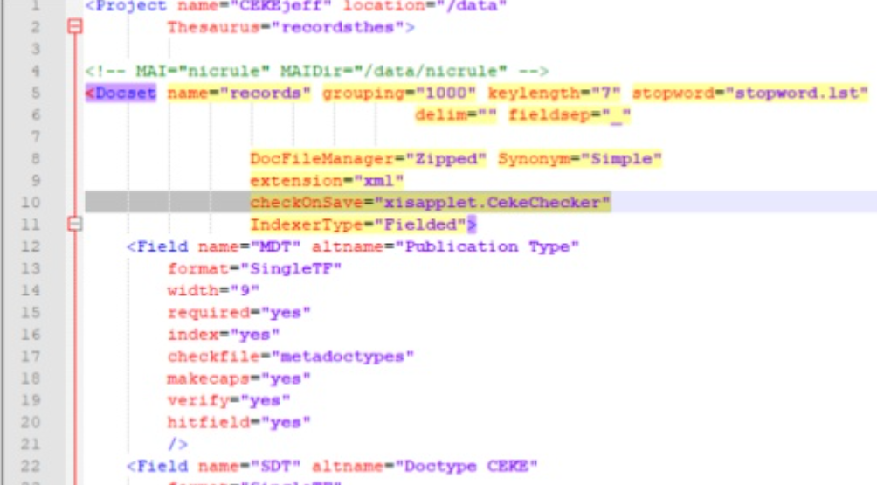
Search Leverage
Search Priority Using the Thesaurus terms
Better precision and recall in search
No false presentations
Insures full coverage of publications
Synonymy fully expanded to match the thesaurus
Searches the thesaurus terms first on the tagged documents
Triple store leverage
Provide new connection options in search
Expand the connections users can make
Knowledge graph presentations for an expanded user experience
Integration first with the current user interface
Expand the options for the users with the new technology behind the scenes

Slide 53
Word and Term Parsing In Search
Stemming
-ing, -ed, -es, -’s, -s’, etc.
Depluralization
Truncation
Left and right
Wild cards
Organi*ation
Variant Spellings
Centre, center
Hyphens

Slide 54
Search Taxonomy Terms First
Tag
Tag the content with the taxonomy
Search
Search the preferred form – taxonomy term first
Add
BUT add all synonyms as equal to the term so they are all searched together
Search
Then search body and abstract title
If desired
If no results on controlled terms

Slide 55
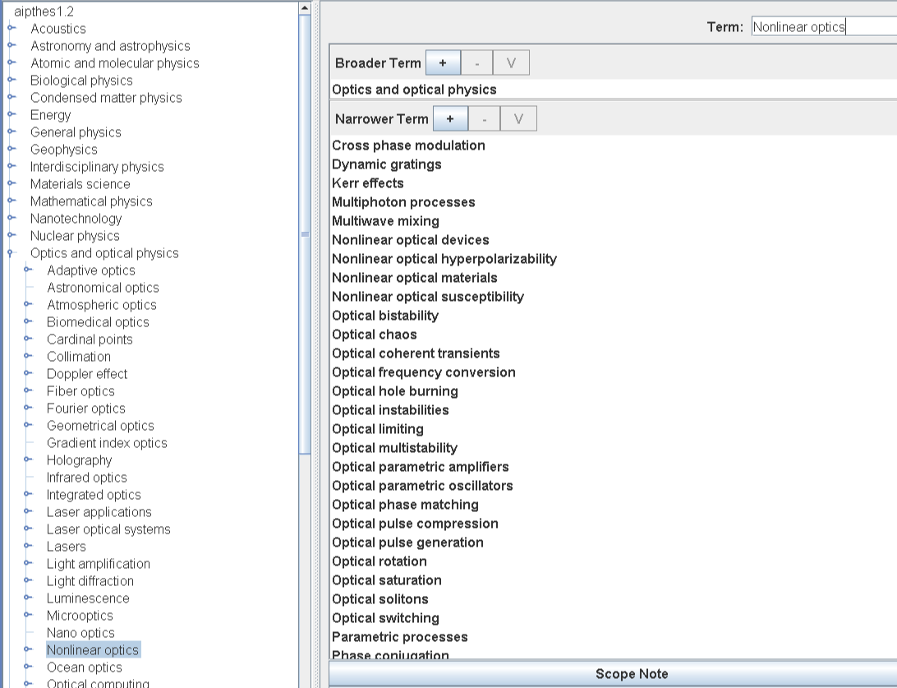
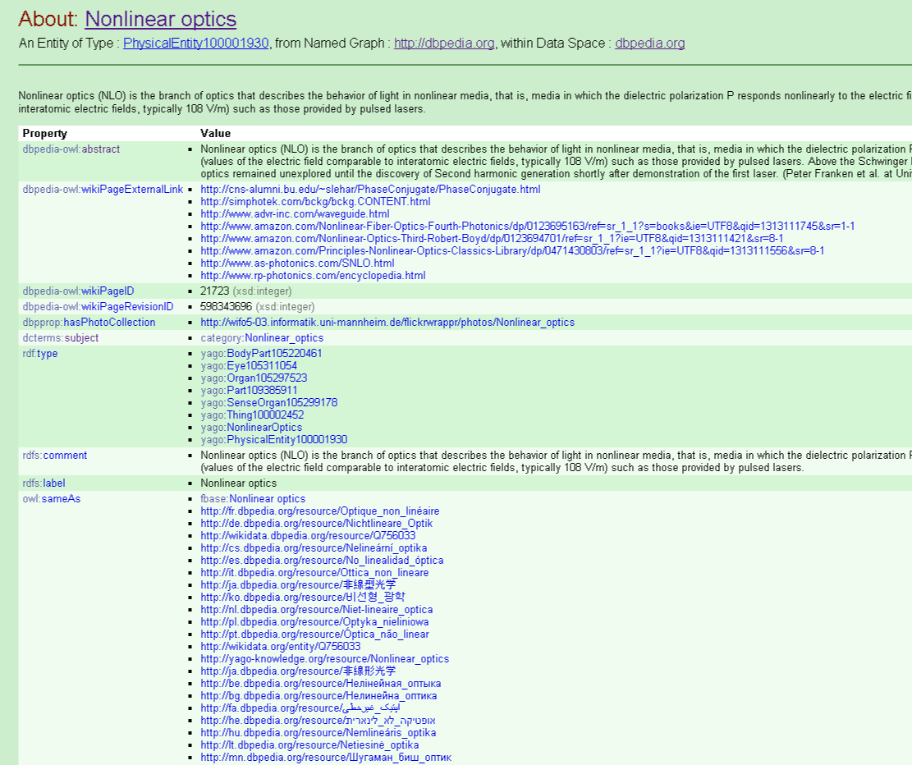
Linked Data
Assert that the AIP Thesaurus term “Nonlinear optics” refers to the same concept
as the dbpedia page “Nonlinear optics” by putting links in both places.

Slide 56
Sample – Search Harmony Deployment
Query
Query fetches hit list from SH, snippets from Repository.
Search Harmony Presentation
Layer
Search
Data forked so y components can serve snippets and docs, and SH can build indexes.
Search Harmony
Index
Auto-completion
NavTree
Narrower Terms
Related Terms
Building search index
Cleanup, etc.
Data base in JATS XML
Repository with fielded data

Slide 57
The User Interface and Experience
The most critical component
User-driven features for speeding the delivery of content
A UI/X driven experience
For configuring document structures
Creates and displays API calls to retrieve/store data
user may copy and paste into their application layer
Allow for on the fly changes to the document schema
Can be configured to automatically serve and update the API settings with no need for input from the programmers

Slide 58
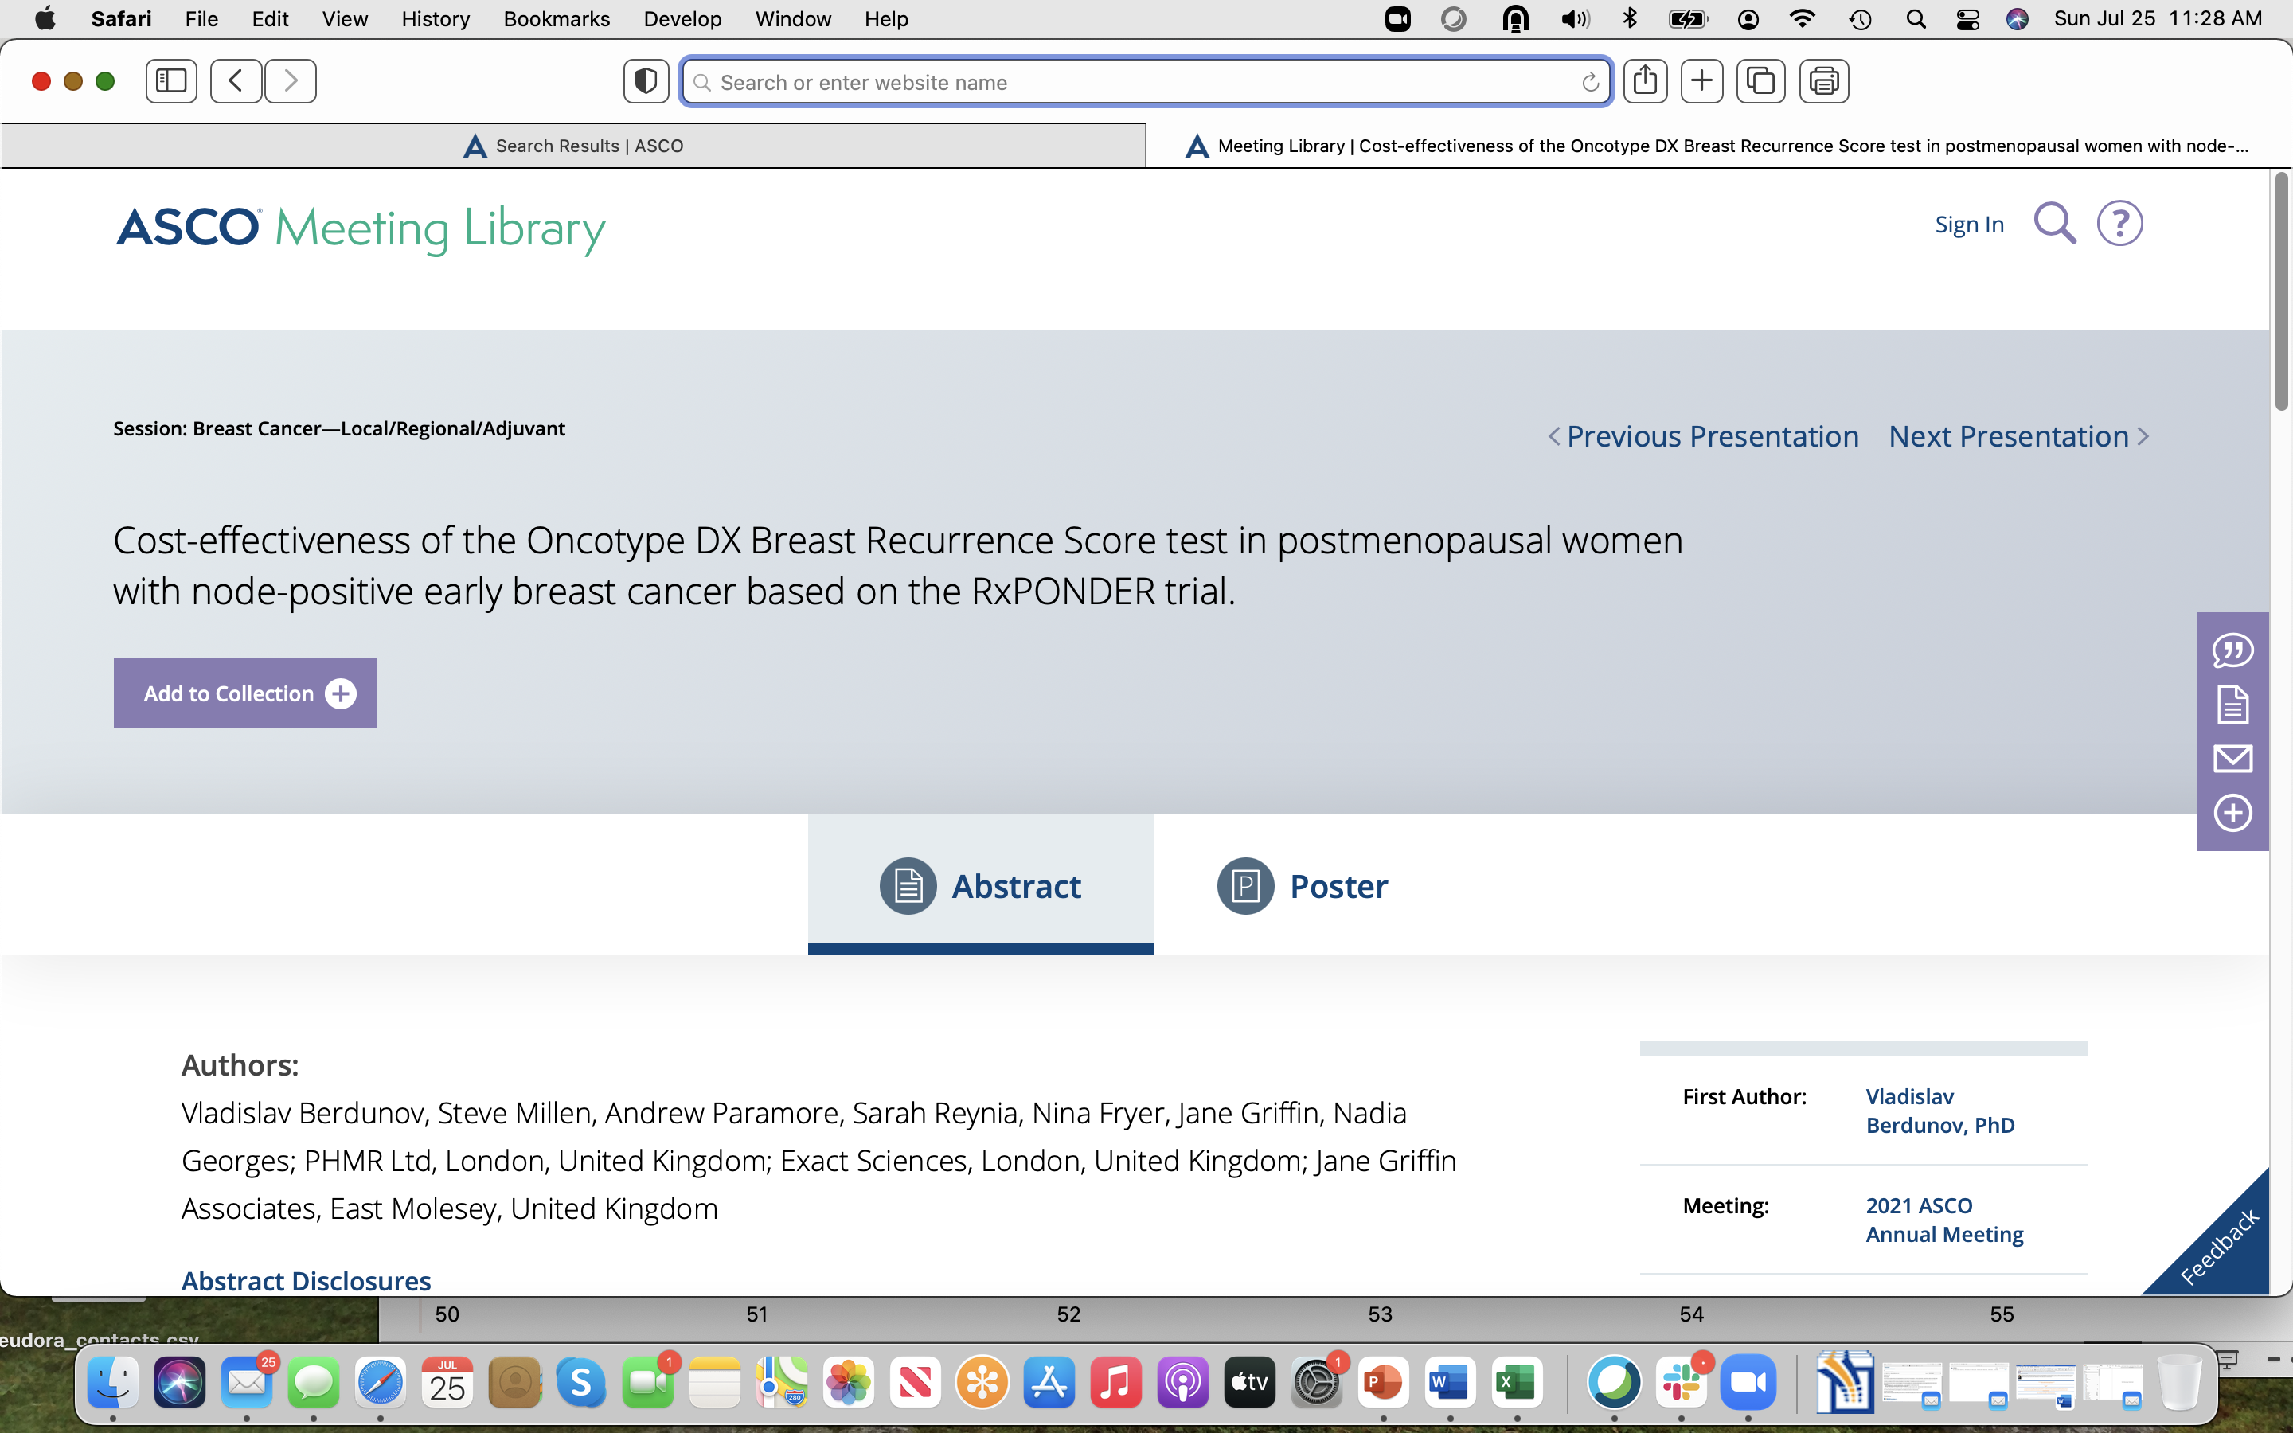
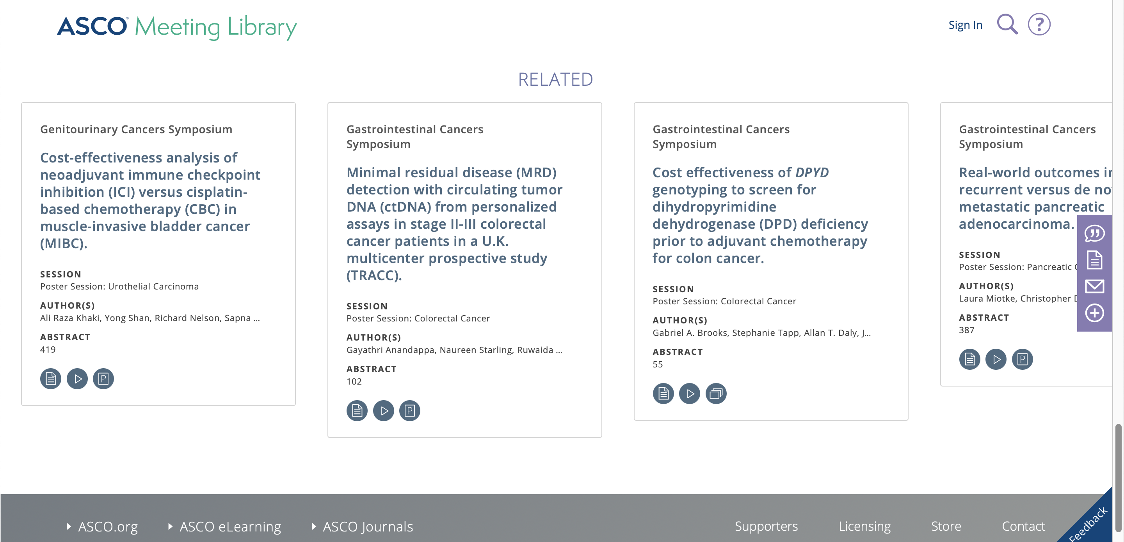
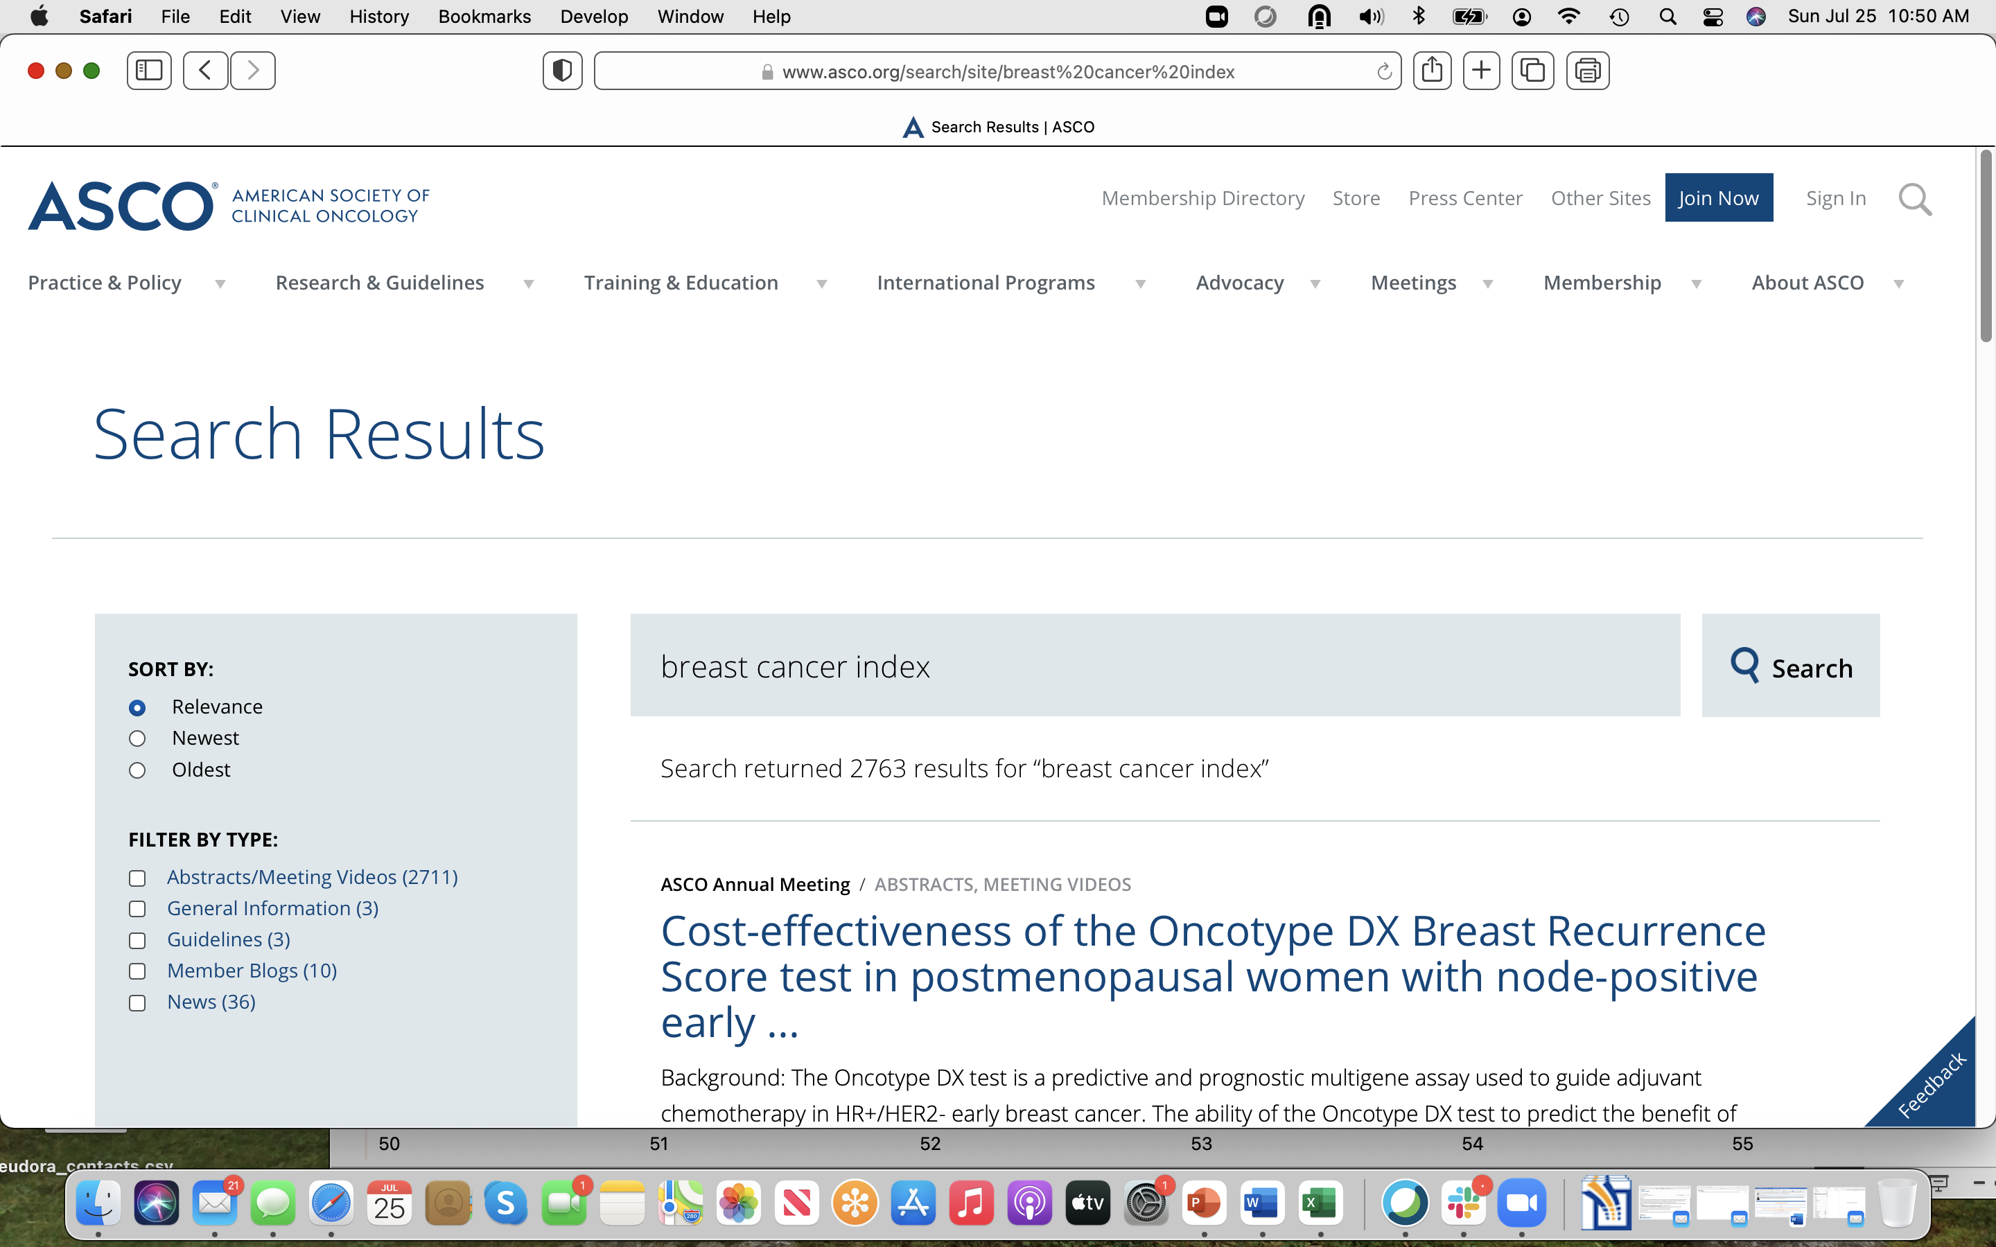
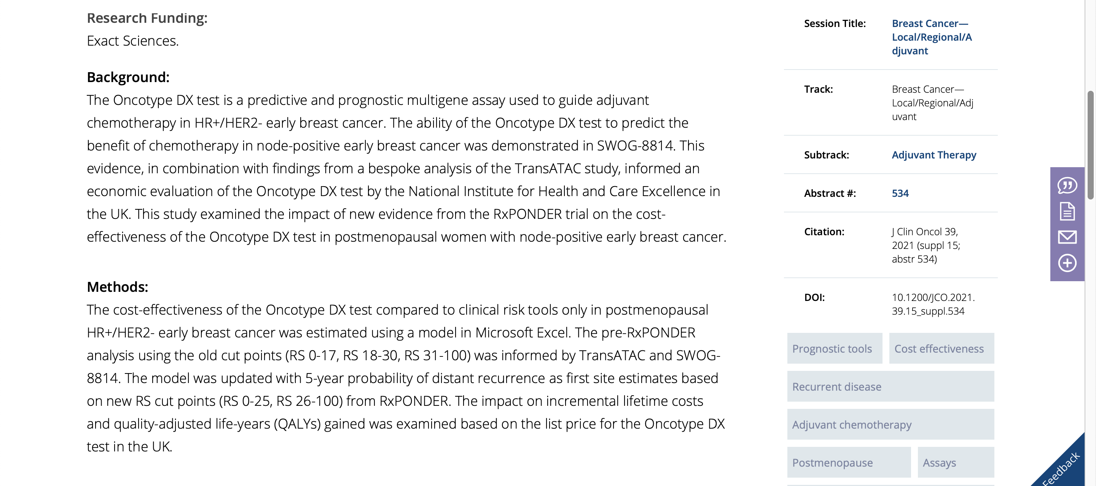

Slide 59
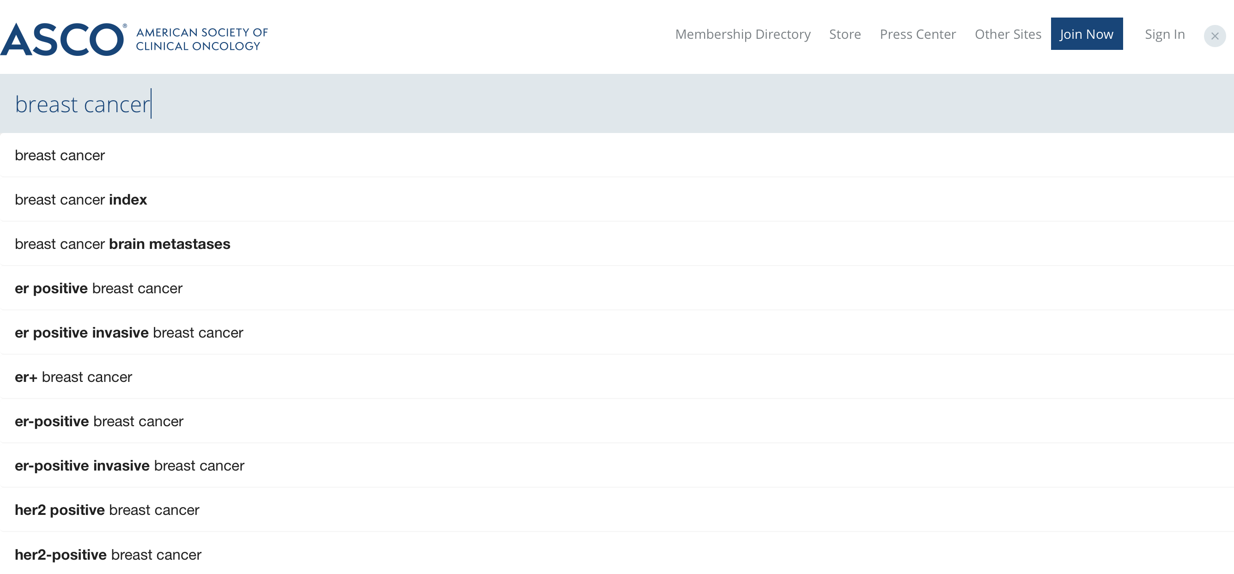

Slide 60
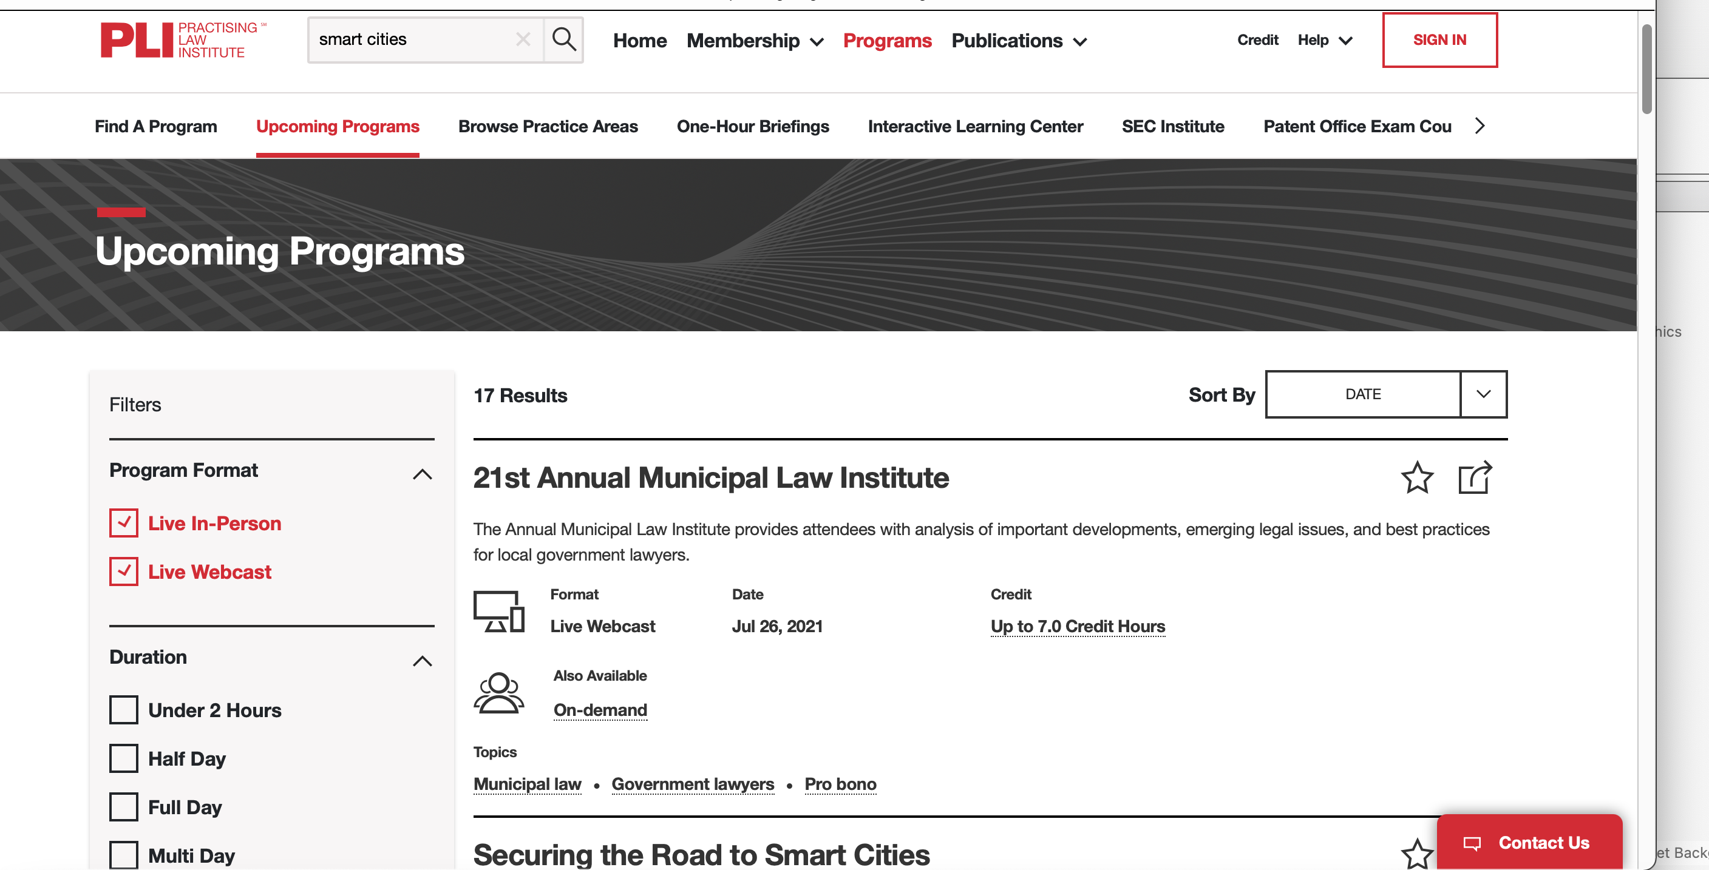
Facet, Field Filter, Refine, variations on a tune

Slide 61
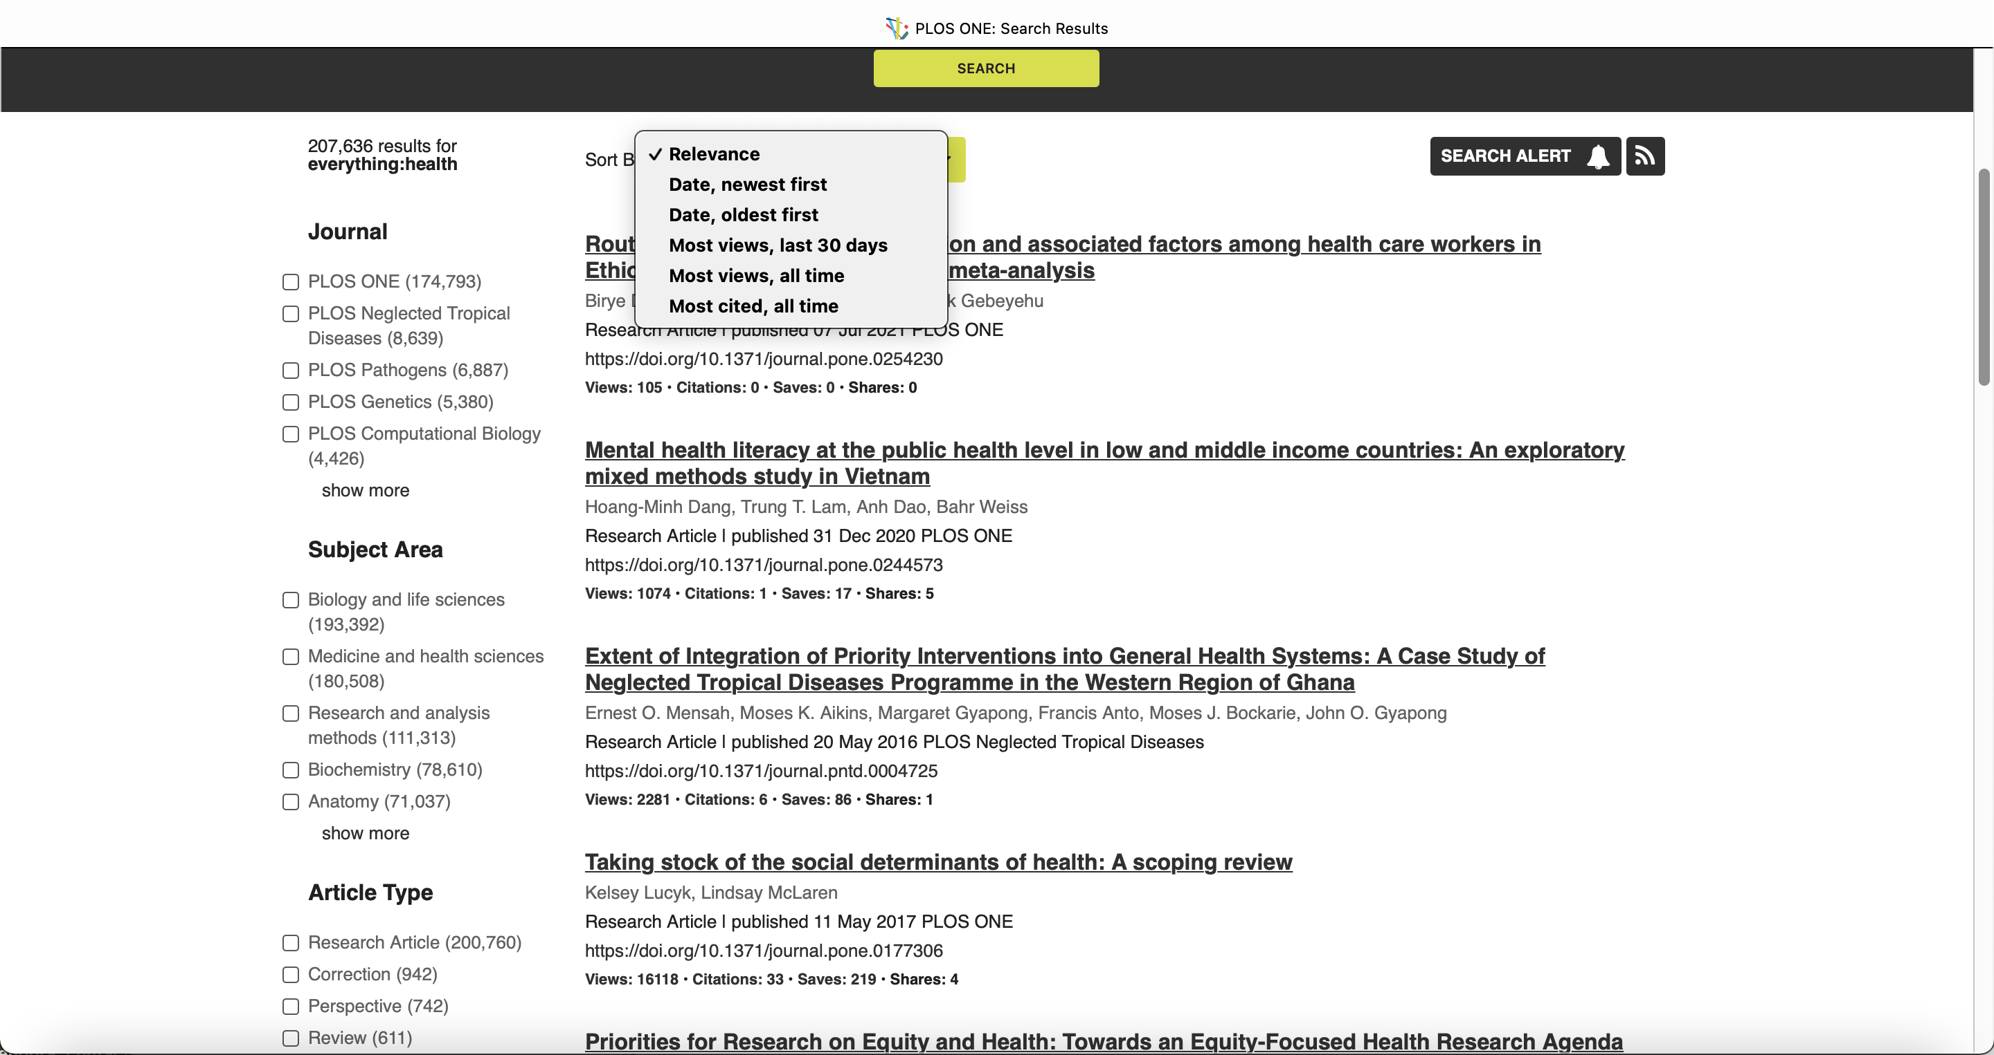
Facets or fields to refine search

Slide 62
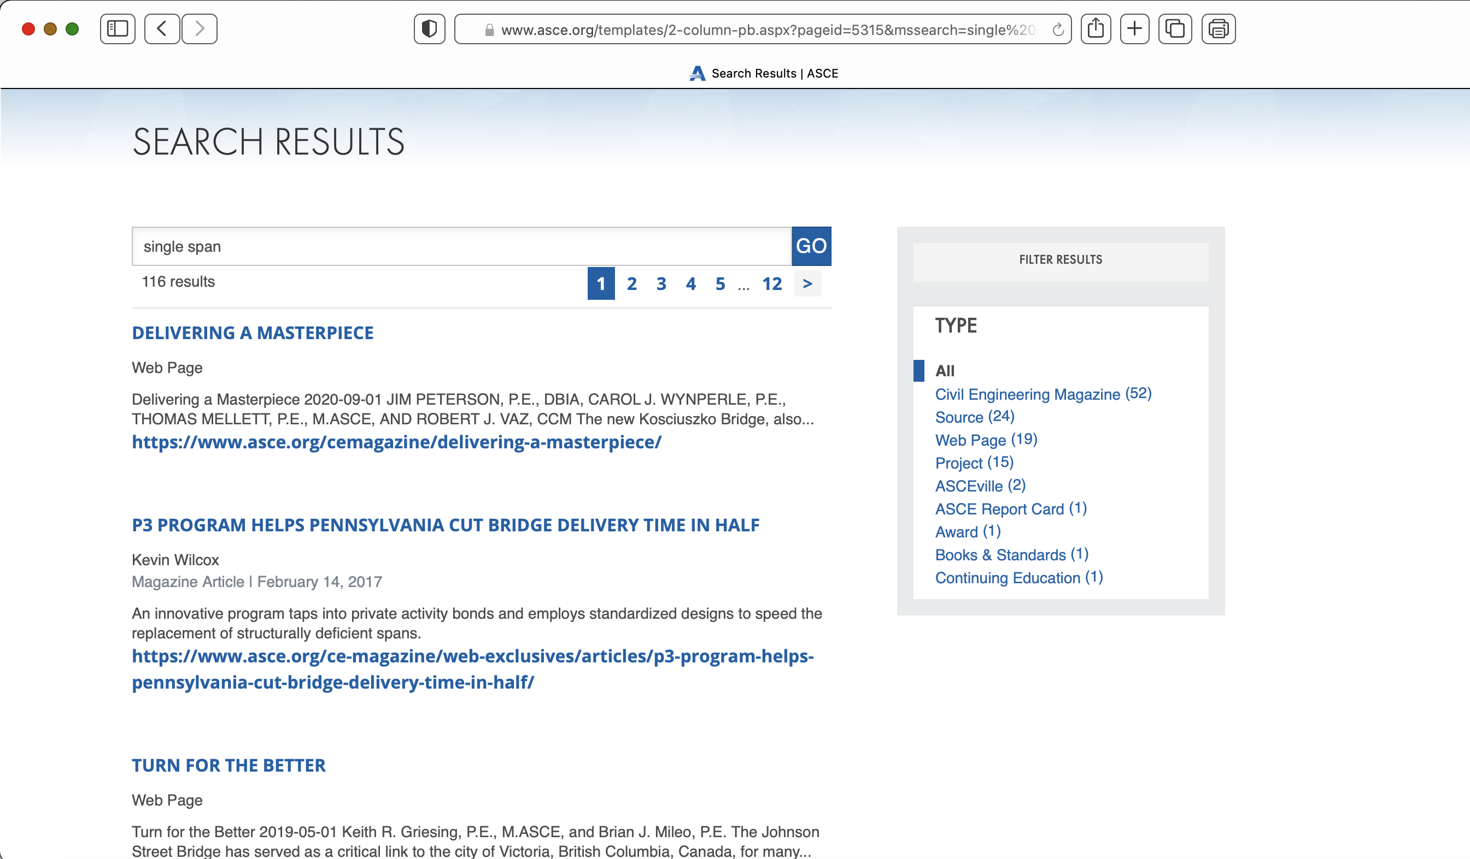

Slide 63
User statistics and analytics
Provide the end-user with a variety of analytics for how their data is accessed
Allow them to make enhancements/improvements to their schemas
Demonstrate the robustness and capability of the platform
Builds consumer trust

Slide 64
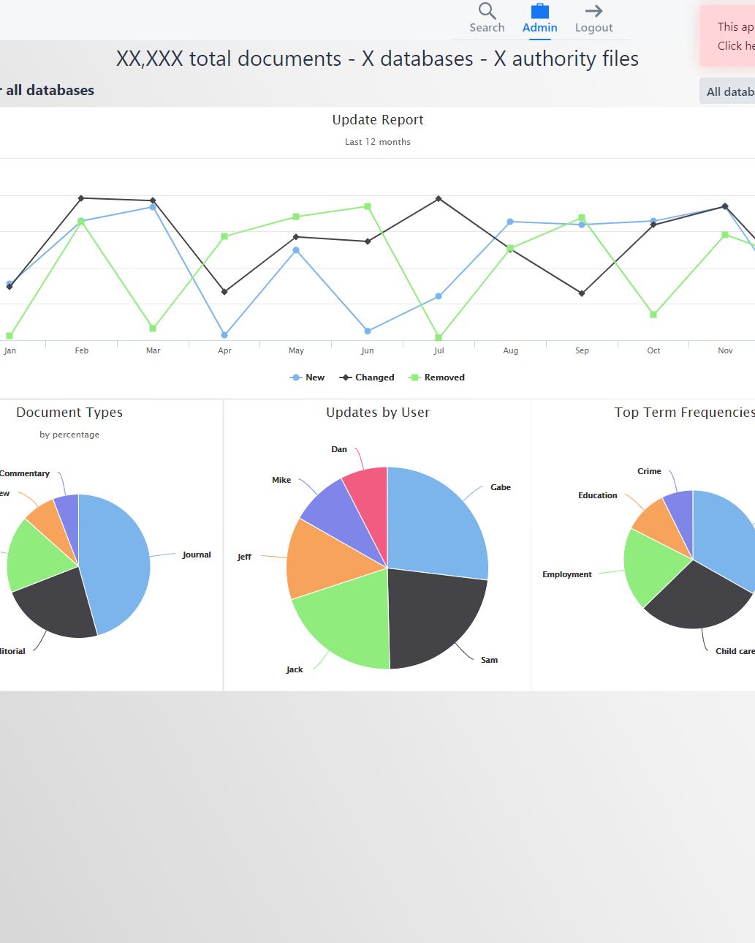
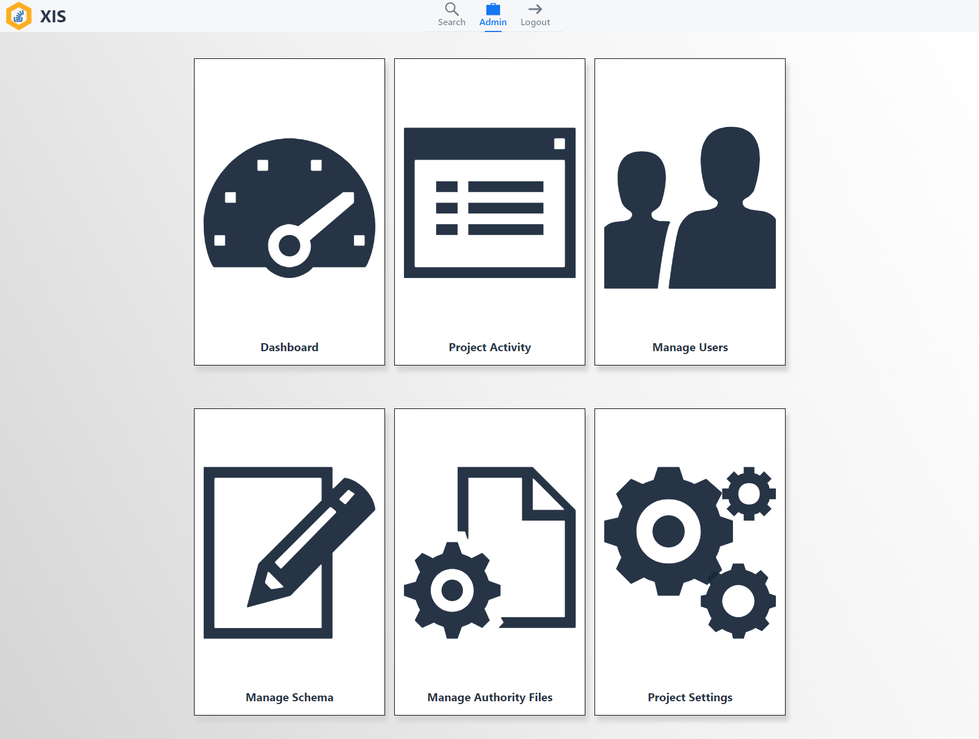
Fully Configurable Project Management
The Dashboard allows for full record control
Including administration view
Modify/Manage XML schema
Record search
View and edit records from within the UI
Dashboard view
Presents the user with various project statistics
Allow for a fluid user experience.
Consider presenting the data in a hierarchical format.

Slide 65
About Access Innovations
Access Innovations are experts in content creation, enrichment, and conversion services. We provide services to semantically enrich and tag raw text into highly structured data. We deliver clean, well-formed, metadata-enriched content so our clients can reuse, repurpose, store, and find their knowledge assets. We go beyond the standards to build taxonomies and other data control structures as a solid foundation for your information.
Our services and software allow organizations to use and present their information to both internal and external constituents by leveraging search, presentation, and e-commerce. We change search to found!
Quick Facts
Founded in 1978
Headquartered in Albuquerque, NM
Privately held
Delivered more than 2000 engagements

Slide 66
Our Software
Data Harmony
XIS (XML Intranet System)®
M.A.I.® (Machine Aided Indexer)
Thesaurus Master ®
Data Harmony Suite
MAIstro™

Slide 67
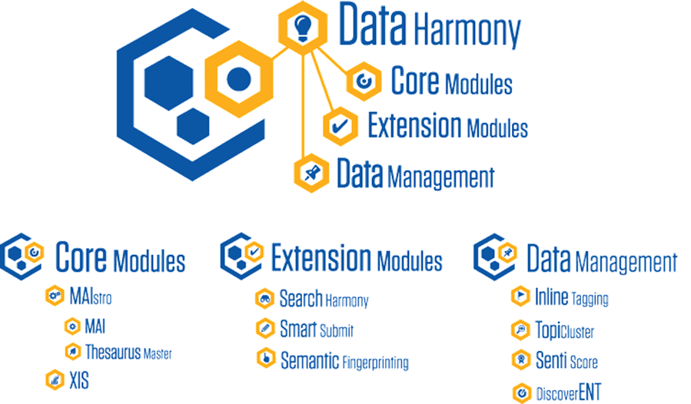

Slide 68
Marjorie Hlava, President
505-998-0800 x109 margie_hlava@accessinn.com

Slide 69
QUESTIONS??
This is an “On Demand” presentation so email to
Margie
Mhlava@accessinn.com
Or call
505-998-0800 x 109
I would love to chat

